Slide 1




UM MADS Capstone: Contamination Site Risk Assessment
Matthew D. Jones | Envirolytica LLC
Co-Founder, Data Scientist
. Envirolytica
Envirolytica LLC
Pg. 1

Slide 2
Agenda
Executive Summary
Project Background
Methodology
Visualization
. Envirolytica
Achievements, Next Steps, and Recognition
Envirolytica LLC
Pg. 2

Slide 3

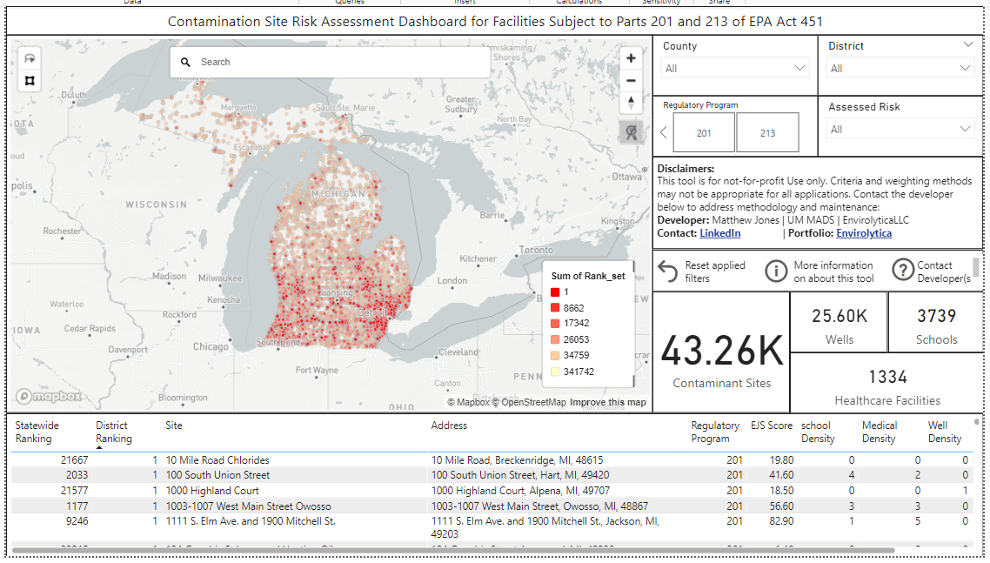
Executive Summary
This capstone project uses public datasets and data science techniques to assess contamination site risk relative to other sites in various EGLE districts. Major accomplishments include:
Assessing 40k+ contaminant sites for public health risks
Using similarity matching to determine which contaminants are likely to exist at new contaminant sites
Creating a script to efficiently perform the analysis and output to user-friendly excel format
Establishing a dashboard to visualize and drill down on contaminant site analysis
Envirolytica LLC
Pg. 3

Slide 4
Project Background
There are more than 24,000 contamination sites publicly reported under Parts 201 and 213 of the Natural Resources and Environmental Protection Act (NREPA) in the state of Michigan. Since financial and human capital limit annual reclamation opportunities, it is important to develop a data-driven method to classify contamination sites according to their risk to the public.
This project ranks the risk of all contamination sites published under the Parts 201 and Parts 213 based on their relative risk to the general public. Public well, school, healthcare, contaminant, and environmental justice data are combined in the assessment to determine the risk.
To conduct the analysis, open-source statistical, geolocation, and automation packages are used in python to rank all 24,000+ contaminant sites quickly (<1hr). All code and documentation are free for government and not-for-profit institutions to use, and published to the public at the link below:
Link: https://github.com/MDJonesBYU/EGLE-Contamination-Analysis/tree/main
*Attribution Required
Envirolytica LLC
Pg. 4

Slide 5



Methodology: Well Risk and Total Risk
Total Risk:
The total risk that each site presents to the public is based on the combined propensity of the site to presents hazards to surrounding wells, schools, and healthcare facilities, combined with the environmental justice score of site and the initial risk assessment EGLE staff determined for the site. Well Risk: contamination risk to wells is determined based on:
Density of wells within 1mi2 of the contaminated site
Proximity of the closest well to the contaminated site
Whether the contaminated is located in a wellhead protection area (WHPA)
The Well risk is ranked from 0 to 200 using min-max normalization, where a maximum risk factor of 100 is allotted if the site has the highest density of wells within 1mi². An additional risk factor of 100 is allotted if the facility has the shortest distance to a nearby well. Finally, if the site is located in a WHPA, then the max risk of 200 is assessed for the facility.
$$Total Risk=School Risk+Healthcare Risk+ Chemical Risk+ Environmental Justice Score+Assessed Risk$$
$$Well Risk=200$$
Is the site within a WHPA?
$$Well Risk=Well Density Value \left(0−100\right)+Well Proximity Value (0−100)$$

Slide 6


Methodology: Healthcare, Schools and EJS
Healthcare and School Risk:
Similar to well risk evaluation, schools and healthcare facilities are evaluated based on the density and proximity of these facilities to the contaminated site of interest. Min-max normalization is applied using the same 0 to 200 boundary. Environmental Justice: Environmental justice scores (EJS) are obtained from EGLE’s draft MiEJScreen dashboard for all areas across the state. Using geolocation analysis, these scores are mapped to each facility , and a multiplication factor of 2 is applied so that the value range is 0 to 200, consistent with the weighting of school, healthcare, and well risks.
Chemical Risk:
To determine chemical risk, EGLE provided a detailed list of known contaminants for each contamination site through a FOIA submitted in [month] of 2023. A basic similarity matching algorithm was applied to determine the most likely contaminant at each site where contaminants were unknown. Detailed weighting for chemical contaminants is provided on the next slide.
$$School Risk=School Density Value \left(0−100\right)+School Proximity Value (0−100)$$
Healthcare and School Risks
$$Healthcare Risk=Healthcare Density Value \left(0−100\right)+Healthcare Proximity Value (0−100)$$

Slide 7



Methodology: Chemical Risk
Chemical Weighting:
In the FOIA from X, 2023 there were 17 categories for chemical contaminants, including a category for chemicals not specified. These 17 categories were reduced to six groupings of related chemicals, and then a weighting factor was applied based on the hazard severity of each chemical. Breakdowns of groupings are provided below, along with the weighting equations. For sites where contaminants were not known, similarity matches predicted the likely chemical, excluding Group 6 from the chemical risk equation. Note: This equation can be updated as chemical priority changes
Group 1: Chlorinated VOC’s and Pesticides
Group 2: PFAS, PCBs and PBBs
Group 3: Hydrocarbons and Petrol products
Group 4: Metals (including lead and mercury), Dioxins, PAHs,
Group 5: Methane, Water Quality Issues, PH concerns, or not classified currently
Group 6: Contaminant not known
$$Chemical Risk\left(not normalized\right)=Group 1+\frac{Group 2}{2}+\frac{Group 3}{3}+\frac{Group 4}{4}+\frac{Group 5}{5}$$
$$School Risk=School Density Value \left(0−100\right)+School Proximity Value (0−100)$$
Healthcare and School Risks
$$Healthcare Risk=Healthcare Density Value \left(0−100\right)+Healthcare Proximity Value (0−100)$$

Slide 8
Methodology: Assessment Risk
Assessment risk for each listed facility was mapped to a numerical value based on the severity documented by EGLE under Parts 201 and Parts 213 reporting requirements. The assessment entry and associated values are mapped as follows:
Risks Present and Immediate → 200
Risks Present and Require Action in Short-term → 150
Risks Present and Require Action in Long-term → 100
Risks Not Determined → 100
Inadequate Data to Assign Risk → 100
Contact Lead Division → 100
Risks Controlled-Interim → 50
Residential Closure (under Section 20101(1)(tt)) → 0
Note: Similarity matching can be performed to improve risk assessment for sites where risk is not determined or where inadequate data exists to assign risk – based on the business type and location

Slide 9
Simplifications and Assumptions:
Current priority assessment applies data reductions to wells, hospitals, schools, and contamination sites considered as detailed below:
Wells are excluded from analysis if any of the following are true:
The well is <50 years old
The depth is < 80 ft. deep
The well type is not listed as a public well (type 1, 2, or 3), irrigation well, or household well
The well’s status is not described as active, unknown, or other
Hospital and Schools Reductions:
Only active hospitals and schools were considered in the assessment. This is not explicit in the code because the filter was applied at the data download source
Contamination Sites are removed from risk consideration if:
Release status is closed
GIS coordinates are not available for the facility
Envirolytica LLC
Pg. 9

Slide 10
Code Implementation
Risk assessment and data cleaning was conducted using the python programming language, with open-source packages including (but not limited to): pandas, geopandas, shapely, numpy, math, and datetime
Shapely’s polygon and point packages enabled determination of contamination sites resided within geographical regions of interest such as wellhead protection areas, environmental justice zones, and county demarcations
The haversine formula was used to determine the relative distance between contaminant sites and protected areas.
Pandas and geopandas were used to read input csv, geojson, and json datafiles to perform data operations, including vectorized matrix manipulation operations.
Datetime was used to read and filter well information based on the data of construction
General Practices:
Following the principles of SAFe (scaled, agile framework), vectorization and other code improvements were only applied in areas to where significant benefits were realized (such as speed enhancement).
Nested for loops and other “non-optimal” code structure is present where efficiency gain was deemed insufficient to modify the code following SAFe methodology.

Slide 11
Going Viral:
This PowerPoint, all pertinent code, and example input/output datafiles are published on GitHub for EGLE to review and utilize if desired. There is no licensing required for EGLE – or any other governmental or not-for-profit organization – to utilize the tools developed for this project. You can view the project on Github here: https://github.com/MDJonesBYU/EGLE-Contamination-Analysis

Slide 12

Visualization
….

Slide 13
Achievements & Next Steps
Achievements:
Created script that analyzes and evaluates contaminant site risk to public of all P201, P213 facilities known to the state of Michigan, output in excel format – easy to visualize in ESRI or other vendor dashboards.
Established visualization dashboard to Drill down and evaluate contamination site ranking by district
Recommendations/Next Steps:
If EGLE has interest using this analysis tool, implement UAT – solicit feedback and update as needed
A similarity matching method should be applied to determine the risk assessment for sites where risk is not determined or where inadequate data exists to assign risk – based on the business type, location, and expected chemicals given the combination of those two factors
Potential Future Projects:
If desired, similar matrix methodology could be applied to map the most efficient route for engineers/technicians to maximize the number of contaminant sites visited per day for assessing contamination risk. If this is desired, this could serve as Project 3 in my UM Capstone for Applied Data Science

Slide 14
Acknowledgements
This project fulfills my capstone requirement for a Masters in Applied Data Science degree from the University of Michigan. A special thanks for the following individuals and their support on this project:
Andrew Munoz-Hernandez – Project Mentor
Dave Bandlow – Critical Project Resource (RIDE and FOIA information)
UMSI Internship Grant Committee – Project Sponsors that funded this opportunity (Katie Dunn, Krystle Forbes, Jordan Hansen)

Slide 15





Thank you
Matthew D. Jones Academic: Mjonesgm@Umich.edu Business: Mjones@Envirolytica.com
www.Envirolytica.com
Please reach out for future projects
Envirolytica LLC
Pg. 15

